Slide 1

Children and young people’s mental health and wellbeing
A needs assessment for Bedford Borough, Central Bedfordshire and Milton Keynes Councils, focussing on prevention, early intervention and access to services
July, 2019
Marimba Carr, Public Health Registrar

Slide 2
Contents
Section | Slides
Introductory slides: | 1-4
Context and National Picture: | 5-12
Stakeholder feedback: | 13-18
Evidence based approaches: | 19-24
Bedford Borough Data | 25-38
Central Bedfordshire Data | 39-50
Bedfordshire Recommendations (BBC and CBC) | 51-55
Milton Keynes Data | 56-69
Milton Keynes Recommendations | 70-74
BBC, CBC and MK data | 75-80

Slide 3
Scope of the health needs assessment:
In Scope –
Out of Scope –
Work going on elsewhere in the system
Prevention and early intervention
Approach to risk and protective factors
Access to services, from universal to specialist services
Transitions
Evidence base for achieving good mental health and wellbeing in children and young people
Neurodevelopment disorders including autistic spectrum disorder (ASD) and attention deficit hyperactivity disorder (ADHD)
Learning Disabilities
  Separate needs assessments being undertaken for learning disabilities
Perinatal mental health
Review of specialist services
Suicide

Slide 4
Process and engagement
Data collection
Public Health England
Child and Adolescent Mental Health Services (CAMHS)
Early Help
Healthwatch reports
VCS reports
Partner engagement
Local Authority
Clinical Commissioning Groups
Voluntary and Community Sector
CAMHs providers
CAMHs service users
Stakeholder events
System wide, 40 attendees
VCS, 16 attendees
Scoping
Final reports and recommendations

Slide 5
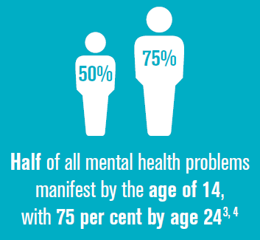
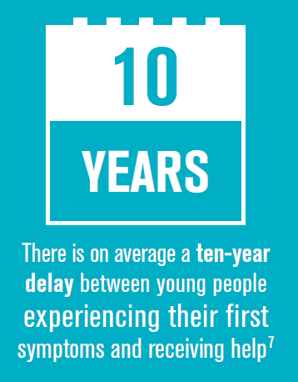
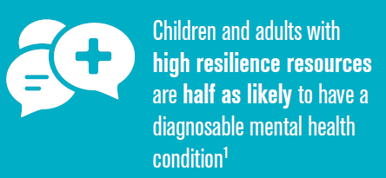
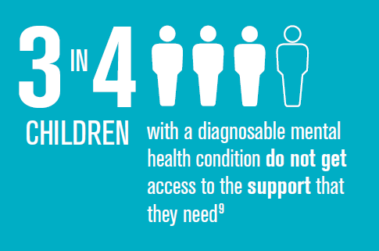
Improving the mental health of children and young people: there is a strong case for prevention and early intervention
Notes:
Burstow, P., Newbigging, K., Tew, J., and Costello, B., 2018. Investing in a Resilient Generation: Keys to a Mentally Prosperous Nation. Birmingham: University of Birmingham.

Slide 6
Mental health is used to describe a spectrum
Mental health conditions/ illnesses and disorder
Mental wellbeing / positive mental health
What is mental wellbeing:
‘a state of wellbeing in which every individual realises his or her own potential, can cope with the normal stresses of life, can work productively and fruitfully, and is able to make a contribution to her or his community’ (World Health Organisation, 2014).
Measuring wellbeing:
There are a number of tools that are used to measure mental wellbeing in children and young people, which measure how they perceive their own situation and experience
Resilience: ability to mobilise personal, relational, and socio-economic resources or ‘capital’ to deal with specific challenges and to thrive or flourish more generally
Mental health conditions:
Emotional
  Anxiety, depressive, mania, bipolar
Behavioural (conduct)
  Repetitive and persistent patterns of disruptive or violent behaviour
Hyperkinetic
  Inattention, impulsivity, hyperactivity
Less common
  Autistic spectrum disorders (ASD), eating disorders, tic disorders, and a number of others
  Source: PHE, 2017
Notes:
Mental Health refers to a spectrum, with mental wellbeing/ positive mental health at one end, and mental illness at the opposite end.
Mental health is influenced by an individual’s resilience and physical health, relationships and the wider social, economic, cultural and environmental conditions in which they live (Bryant, Heard, & Watson, 2015)
PHE 2017: https://digital.nhs.uk/data-and-information/publications/statistical/mental-health-of-children-and-young-people-in-england/2017/2017

Slide 7
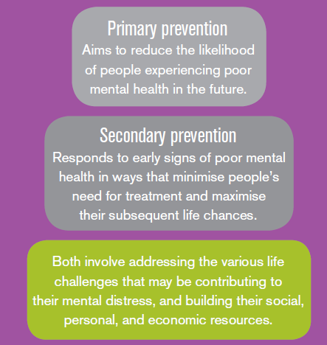
Reducing the prevention and treatment gaps
The ‘treatment gap’ is the difference between those who may need treatment and those who actually receive it.
The ‘prevention gap’ refers to those who would derive benefit from preventative activity and the current extent of that activity.
Notes:
“Treatment gap”– many CYP who need treatment don’t actually receive it.
“Prevention gap” which refers to those who would benefit from preventative activity, and the extent of the current extent of that provision in our areas.

Slide 8
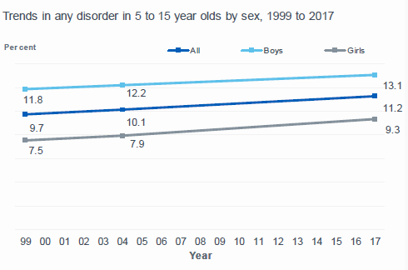
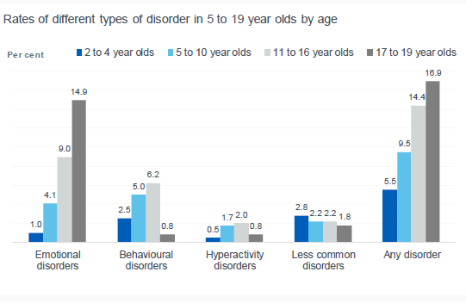
Slight increase in rates of diagnosable poor mental health since 1999 nationally
National prevalence by age group (2017):
  5.5% in 2-4 year olds
  10.1% in 5-15 year olds
  16.9% in 17-19 year olds
  Emotional disorders are the most common
Those who are more likely to have poor mental health:
Boys more likely in younger age groups; girls more likely in older aged groups
Girls aged 17 to 19 were more than twice as likely than boys that age (23.9% compared with 10.3%)
Those from low income families, living in families experiencing difficulties or with parents with poor mental health, and those with poor general health.
LGBT or other sexual identity (34.9%) compared with those who identified as heterosexual (13.2%).
Notes:
National data from the most recent PHE survey of CYP MH, carried out in 2017. This showed that there has been a slight increase in rates of diagnosable poor mental health since 1999. Prevalence increases with age, with 5.5% of 2-4 yo having a diagnosable condition, 10% of 5-15yo and 16.9% of 17-19 yo.
Boys were more likely in younger age groups, girls in the older aged groups. Girls 17-19 were more than twice as likely to have poor mental health (24% compared with 10%). Further risk factors included living in low income families, having parents with poor mental health, and children with poor general health. Those who identified as LGBT were also more likely to have poor mental health.
https://digital.nhs.uk/data-and-information/publications/statistical/mental-health-of-children-and-young-people-in-england/2017/2017
In 2-4 year olds: Less common disorders (2.7%, includes autism, selective mutism, attachment disorders), behaviours (2.5%), emotional (1%), hyperactivity (0.4%). More common in pre-school boys from white backgrounds; higher in North of England. Higher in those with poor health (21.6% compared with 3% of those with good health); Higher in children whose parents have poor mental health, and in families with less healthy functioning; parents with low income and in receipt of benefits related to disability.

Slide 9
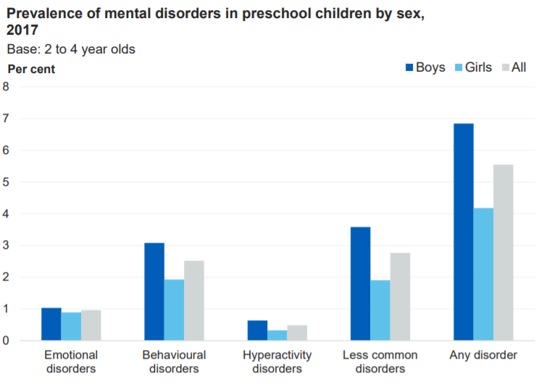
Key factors associated with diagnosable mental health in preschool children include having poor general health, having parents with a poor mental health, living in families experiencing difficulties, and in families with low income
Characteristics of children aged 2-4 who were more likely to have a diagnosable mental health (MH) condition:
Demographics: Preschool boys from white ethnic backgrounds, and preschool children in the North of England
Health: Children with fair, bad or very bad health compared to those with good health
Family: Children who’s parents showed signs of a common mental health disorder, and those living in families experiencing difficulties
Socioeconomics: Children living in the third of households with the lowest income; preschool children who lived with a parent in receipt of benefits related to low income and disability
Neurodevelopment disorders (e.g. autism) and behavioural disorders are most prevalent MH conditions in 2-4 year olds for which there is a separate needs assessment being undertaken.
Notes:
PHE, national survey data 2017.

Slide 10
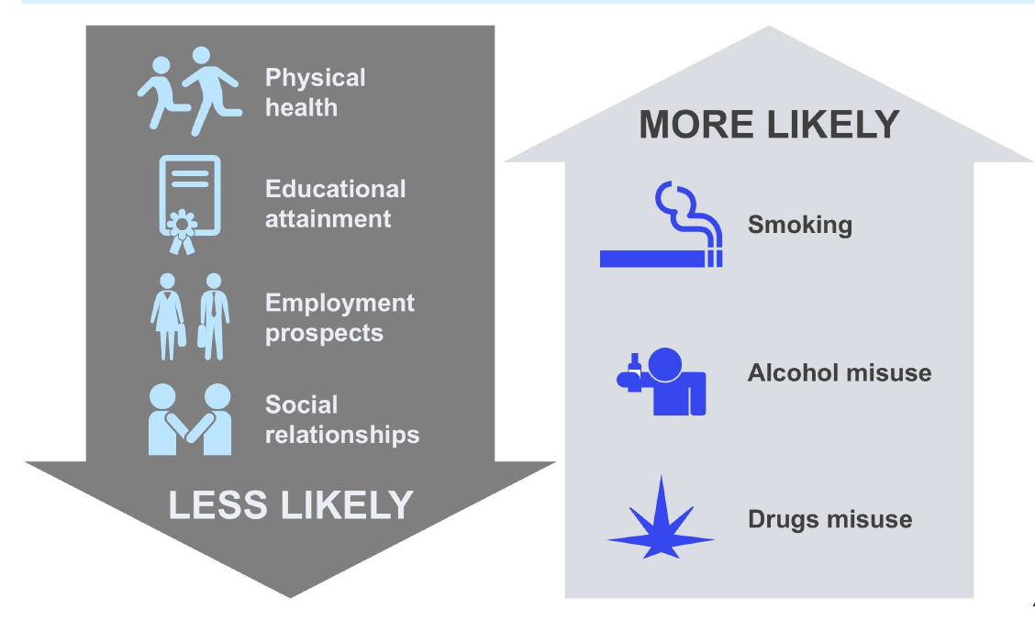
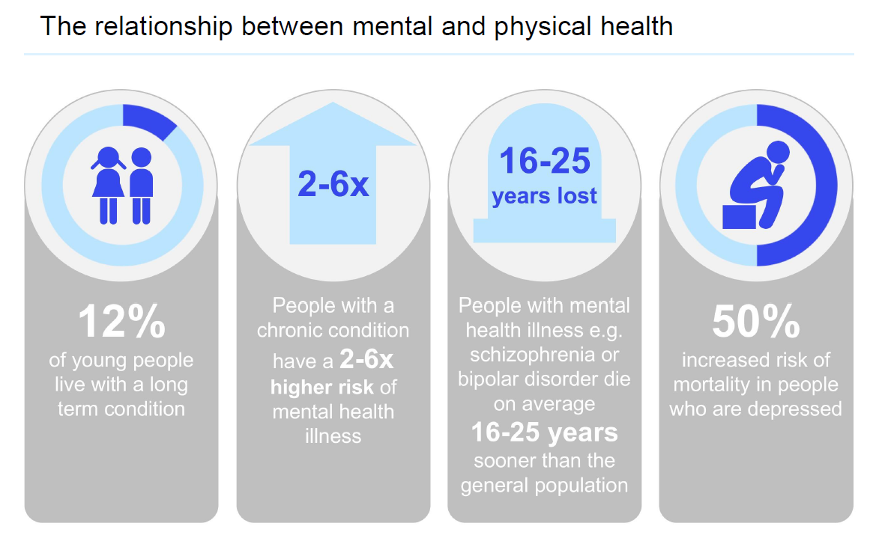
Those with poor mental health have poorer life outcomes
People with poor physical health have a 2-6 × higher chance of mental illness
Notes:
It is important that physical and mental health are considered with an integrated approach, as those with poor physical health are also more likely to experience poor mental health. Those experiencing poor mental health are less likely to have good physical health, educational attainment, they have worse employment prospects and social relationships. On the other hand they are more likely to smoke, and misuse alcohol and drugs.

Slide 11
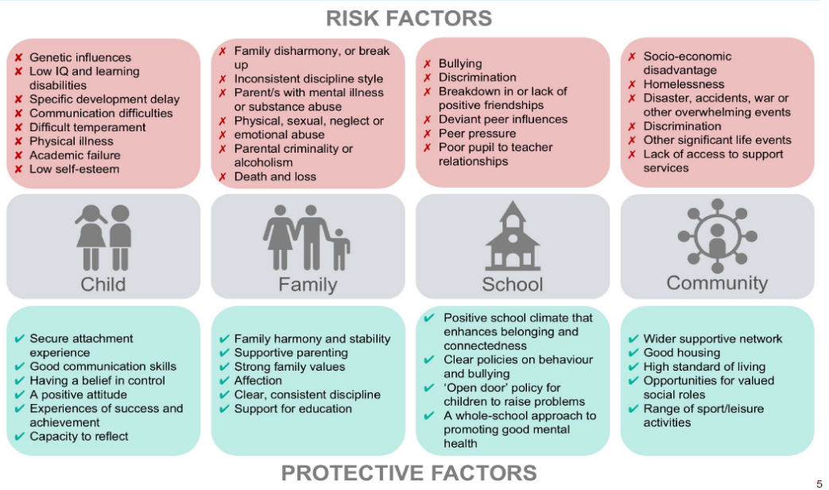
Risk and protective factors for mental health
Notes:
Source: PHE, 2016
Understanding the risk and protective factors for mental health and wellbeing can support the development of approaches to prevent poor mental health, and intervene where there is increased risk. This is a useful infographic developed by Public Health England which outlines the risk and protective factors at four levels – child, family, school and community. This will inform our first table discussion later on so I won’t do into the detail at this point.

Slide 12
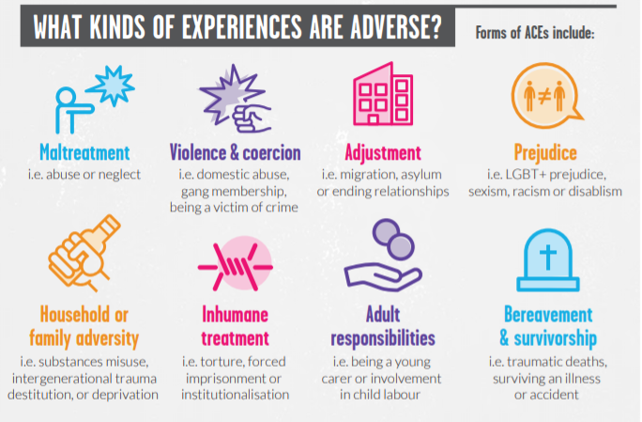
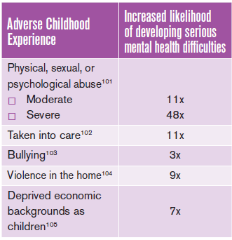
Adverse childhood experiences are a significant determinant of poor mental health
Notes:
Source: Youth in Mind 2018 ; Burstow, P., Newbigging, K., Tew, J., and Costello, B., 2018. Investing in a Resilient Generation: Keys to a Mentally Prosperous Nation. Birmingham: University of Birmingham.

Slide 13
What children and young people said
Sandy Youth Mental Wellbeing Project: Youth Action and Health Watch, 2018
Young people don’t always feel involved in decision making “they decided” ; “they didn’t believe me”
A young person had been identified as needing counselling services; however, they indicated that this had never happened.
Young people felt they needed to know more about the care, diagnosis and recovery options available to them. It is clear that access to the right information and advice in a format that is user-friendly to young people, is essential.
Talking to someone about mental health issues or concerns, whether it be a friend, family member or a professional, is the best advice to give young people.

Slide 14
Points from discussion with Bedfordshire CAMHs service users
It would be helpful if schools know what support is out there. And listen, even if they don’t have the answers
Majority of feedback from CAMHs service users, needing specialist support, on support from GP was negative
Could have more information about MH in GP surgeries – screens, eye catching posters
Internet and social media means CYP are exposed to things sooner. Can get abuse through social media
School doesn’t want younger pupils exposed to information about LGBTQ
Adults with MH are taken more seriously than CYP – CYP are said to be over-exaggerating.
Parents vary – not all want to attend parent sessions to find out more about mental health
Not going to get a big social change without tackling the stigma. Language is important
I was bullied for 4 years at school – the one being bullied is isolated if they report it
School “spaces” for support are not always appropriate
CYP with physical conditions are treated better that those with poor mental health
Parents had to travel 4 hours to visit me. Some of the nicest people worked on inpatient ward

Slide 15
Key themes from discussions with partners
Impact of internet and social media
Access to services
Environmental challenges
Instability of funding for some programmes
Waiting times for services (counselling, CAMHs, MIND)
Need outreach for most vulnerable who do not attend appointments
Cases becoming more complex – unstable families, gangs, exploitation
Schools help to identify the need. Academies – no accountability.
CYP living with parents waiting for MH services
Supporting the most vulnerable
Variable GP response to CYP presenting with poor MH
Variable counselling provision across the system
Lots going on in the system – but is it evidence based?
Families with no recourse to public funds
Lack of understanding of what its like for Children in Care
Need to address bullying in schools and colleges
System or place specific challenges
Lack of Tier 4 provision locally – children placed out of area
If need identified at aged 17, nearly 18 – difficult to access services
Challenges with transitions were identified across all three areas

Slide 16
What young people and local partners say - MK
Children and Young People
Voluntary Sector
What are CYP looking for in a CAMH service?
Choice and flexibility in how they get their care
To know they’re not being judged
Help early…when they start having problems
To be involved in shaping services
Frustration from not knowing how or where to find out what is available to support CYP
Pressure to deliver more for less
Lack of early intervention and low level support
Thresholds for those seeking help are rising
Overview of CAMHs Tier 2 contract 2015- 16
Private and social enterprises delivering services previously delivered by public and voluntary sector
Appears to be less stigma, at least in some communities, to discuss mental health
Look at whole picture
Support for low level mental health needs
More support groups in schools for
More environments for CYP to talk about self-esteem/ confidence concerns
More support for parents
Need MH awareness training for workers, support for families, strategic investment in play, arts and culture, capacity building in voluntary sector and support for new providers
Emphasis from funders on results, targets and ‘hard evidence’ rather than preventative, user-led initiatives
Support for bullying
Positive relationship guidance & support
MySayMK Conference, 2016

Slide 17
Voluntary sector - challenges
VCS need to be more prominent in whole systems approach, and role better understood
Short timescales to work client groups with complex needs don’t work
FUNDING – Local authority funding has been cut, increased demand on all funds
MH support being provided by unqualified / untrained individuals
Increasing demand
Long waiting lists and waiting times
Pressure on schools to deliver too much
Need more outreach, disaffected YP aren’t used to having support
Pathways for support are not clear
Staffing / volunteer levels – too much reliance on good will
Crisis management trumps early intervention

Slide 18
Voluntary sector - opportunities
Peer mentors; referral pathways to services
Bring skills and resources to the table
Attract a large amount of FUNDING to the local area
Innovation
VS agencies who deliver specialist services e.g. LGBTQ / Gangs/ CSE can support delivery of training
Collaboration
Young Unaccompanied Asylum Seekers Forum Partnership between housing, health, children’s services and VCS
Peer support
VS are more approachable / community based so see the issues first hand. This enables them to be responsive to meet the gaps
Provide support through transitions periods – work with YP up to age 25
BUILD TRUST with young people through activities

Slide 19
What works in the early years?
Enhanced perinatal support with a specific focus on the mental health of mother and infants e.g. Health visiting, home and family-based support
Intensive support for families facing difficulties: Strengthening Families, Incredible Years; Inter-parent relationship; Video Interaction Guidance
Preschool programmes supporting school readiness, communication and development of social and emotional skills
Pathways complying with NICE guidance
Notes:
References:
https://digital.nhs.uk/data-and-information/publications/statistical/mental-health-of-children-and-young-people-in-england/2017/2017
Goldie, I., Elliott, I., Regan, M., Bernal, L., and Makurah, L. (2016) Mental health and prevention: Taking local action London: Mental Health Foundation
Burstow, P., Newbigging, K., Tew, J., and Costello, B., 2018. Investing in a Resilient Generation: Keys to a Mentally Prosperous Nation. Birmingham: University of Birmingham.
Local CAMHs referral data
Children aged 2-4: Milton Keynes: 11,901; 31 2-4yo were referred to CAMHs Oct17-Sept18 (0.26%)
BBC: 6,859
CBC: 10,903
National data indicates that 5.5% of children aged 2-4 have a diagnosable MH condition – the most prevalent were neurodevelopmental conditions. Locally children identified are referred to the community paediatrics service. Questions we can ask of the system include… The evidence baser for what works in the early years includes enhanced support during and after pregnancy for mothers, babies and families.; Intensive support for those who are experiencing difficulties. Exmaple programmes include … Preschool programmes which support school readiness, communication, social and emotional skills are also key. AS is having local pathways which are NICE compliant.

Slide 20
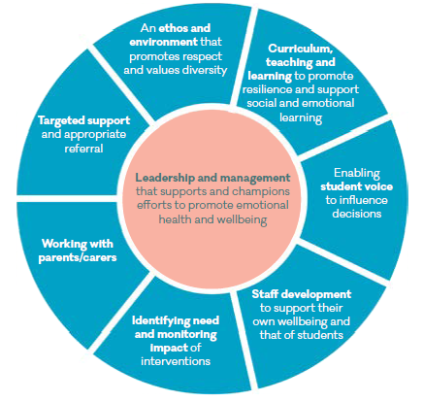
A whole school approach to mental health within in all aspects of school life is key to building resilience in children and young people
Building resilience – what works?
Whole school social and emotional learning programmes that are universal, but can offer support for more vulnerable children
Addressing harmful behaviour – bullying, substance misuse and reducing exclusions
Supporting successful transitions in education and into employment
Schools and colleges to support mental wellbeing of their workforce
Notes:
Goldie, I., Elliott, I., Regan, M., Bernal, L., and Makurah, L. (2016) Mental health and prevention: Taking local action London: Mental Health Foundation
Burstow, P., Newbigging, K., Tew, J., and Costello, B., 2018. Investing in a Resilient Generation: Keys to a Mentally Prosperous Nation. Birmingham: University of Birmingham.
So what works to build resilience in CYP – having a supportive environment is very important. This may be school, a work place, a supportive community. Approaches that support this incude a WHOLE SCHOOL approach – providing universal support but alos support for more vulnerable children. The wheel shown here show the mai elements of a whole school approach to mental wellbeing. Having effective ways of dealing with BULLYING and other harmful behaviour. Periods of transition are challenging in CYP this could be changing schools – primary to secondary, moving home, leaving school and starting university, for those in contact with specialist services it may transitioning from CAMHs to AMHS. For young people in employment, a supportive working environment is also important.

Slide 21
Approaches to improve the mental health of the population
Whole population approaches
  strengthening individuals and communities, addressing wider determinants
Life course approaches
Targeted prevention
  groups at higher risk
  individuals showing signs and symptoms
  people with mental health problems
Groups at increased risk:
Children and young people from low income families
Looked after children, children in need
Black and minority ethnic groups
Homeless / at risk of homelessness
Lesbian, gay, bisexual, transgender and queer
Those seeking asylum
Young offenders, or at risk of offending
CYP going through transitions: child to adult/ community services; between education; education to employment; change in life circumstances
Excluded or at risk of exclusion from education
Going digital: e-headspace, successful Australian national digital delivery service
Notes:
A standout example of good care is e-headspace, the Australian national digital delivery service for youth mental health. It provides an online and telephone support and counselling to young people aged 12–25, their families and friends and functions as a portal to further support, allowing people to access the correct services.
https://www.nhsconfed.org/news/2019/03/mhn-digital-release
Mental Health Foundation – a vision for prevention outlines key policy areas

Slide 22
Population approaches evidenced to improve MH
Improving MH literacy
Improving MH literacy of public service workforce
Mentally healthy communities and places
Secure base for vulnerable families (income, housing, access to health, education and employment
Reduce stigma and discrimination
Evidence based activities focused on sustained behavior change
Integrated health and social care approaches
Workforce able to identify and act on impact of MH inequalities e.g. Black, Asian and Minority Ethnic groups, LGBT
Enable self management within communities, peer support, adapt for those with long term conditions
Asset based community development – actively involve individuals and communities
MH is measured as an outcome in investment/ regeneration
Create and protect green spaces
Making Every Contact Count, Health visiting, schools, housing and social care
Awareness raising and education, reduce social distance
Approaches targeted to where there is most need, and were the greatest impact can be achieved in improving health, employment and education
Consistent, recovery focused messages, challenge stereo types
Integrate mental and physical health care – improve quality and efficiency, and outcomes
Workforce development, support for those with poor MH to navigate the system
Access to psychological support
Joint planning of health, mental health and social care interventions (Local Authorities, primary care, voluntary and community sector)
Universal and targeted approaches eg. Housing First
Summarised from the EIF’s Mental Health and Prevention: Taking local action for better mental health (2016)
Notes:
There are a number of population approaches including: improving mental health literacy across the system – public services, addressing inequalities and self-management; mentally healthy communities and places including universal and targeted approaches, and community development approaches; Reducing stigma and discrimination and interated health and social care approaches.
ALSO look at Mental Health Foundation – A vision for prevention
Goldie, I., Elliott, I., Regan, M., Bernal, L., and Makurah, L. (2016) Mental health and prevention: Taking local action London: Mental Health Foundation
Burstow, P., Newbigging, K., Tew, J., and Costello, B., 2018. Investing in a Resilient Generation: Keys to a Mentally Prosperous Nation. Birmingham: University of Birmingham.

Slide 23
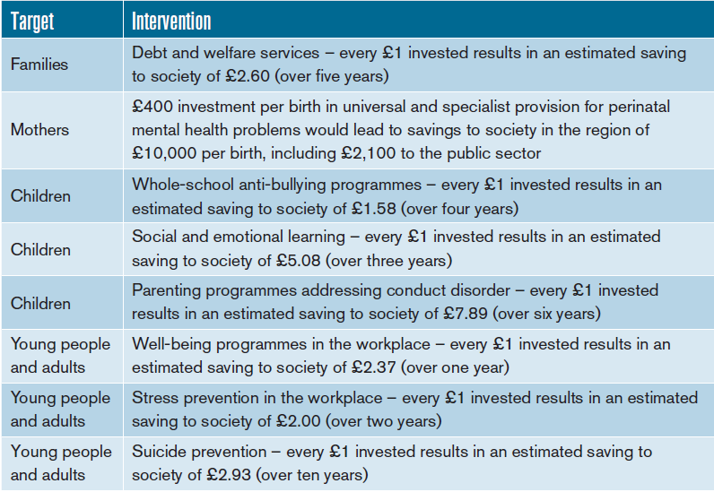
Evidence for savings from investing in prevention
Burstow et al 2018. Investing in a Resilient Generation: Keys to a Mentally Prosperous Nation. Birmingham: University of Birmingham.
Notes:
Burstow, P., Newbigging, K., Tew, J., and Costello, B., 2018. Investing in a Resilient Generation: Keys to a Mentally Prosperous Nation. Birmingham: University of Birmingham.
Research has also been done to evidence the potential savings from investing in prevention,

Slide 24
Government School’s Green paper proposals
What are the implications locally of NHS Long Term Plan
Core proposals 20-25% of schools by ‘22/23:
Incentivise and support all schools and colleges to identify and train a Designated Senior Lead for mental health.
Fund new Mental Health Support Teams, which will be supervised by NHS children and young people’s mental health staff
To pilot a four week waiting time for access to specialist NHS children and young people’s mental health services.
In addition:
Department for Education supporting a Whole School Approach to mental health
Focus on physical health: sporting future; child obesity plan
Online Safety
Increasing emphasis on self-care & management including common mental health problems
Increase physical health checks for those with severe mental illness
Support for young carers, who are are risk of poor MH
Expanding MH services for children and young people – to improve access to services, including those aged 18-25 years.
NHS 111 to be single point of access and source of community MH support 24/7

Slide 25
Bedford Borough Slides

Slide 26
Presenting the data and making comparisons
The following performance data is presented for a number or relevant indicators:
  Bedford Borough
  England
  Data for local authorities in the 4th least deprived decile in England, which includes Bedford Borough
  Data for Local Authorities with the best performance for each indicator (95th centile)
Bedford Borough data is compared (RAG) to the average of other areas in England within the same deprivation decile (4th least deprived) where available.
Where unavailable, comparisons are made to with England
Bedford Borough – 4th least deprived decile
Notes:
Given the geographical areas covered by this needs assessment, I though it would be helpful to give some context as to how the data comparisons and RAG ratings are made within the presentation. Firstly where possible, RAG ratings have been made with other areas in England within the same deprivation decile – or 10%.

Slide 27

Do we understand the picture of mental wellbeing in our 0-5 year olds?
Nationally 5.5% of 2 to 4 year olds have a diagnosable MH condition (PHE, 2017).
The most common are neurodevelopment conditions, including ASD
Applied to the local population, that is
377 children in Bedford Borough
Are we identifying under 5s who need support and referring appropriately?
Are we picking this up early enough, e.g. through development checks, home visits, contact with other services?
What about those with low level needs?
Notes:
References:
https://digital.nhs.uk/data-and-information/publications/statistical/mental-health-of-children-and-young-people-in-england/2017/2017
Goldie, I., Elliott, I., Regan, M., Bernal, L., and Makurah, L. (2016) Mental health and prevention: Taking local action London: Mental Health Foundation
Burstow, P., Newbigging, K., Tew, J., and Costello, B., 2018. Investing in a Resilient Generation: Keys to a Mentally Prosperous Nation. Birmingham: University of Birmingham.
Local CAMHs referral data
Children aged 2-4: Milton Keynes: 11,901; 31 2-4yo were referred to CAMHs Oct17-Sept18 (0.26%)
BBC: 6,859
CBC: 10,903
National data indicates that 5.5% of children aged 2-4 have a diagnosable MH condition – the most prevalent were neurodevelopmental conditions. Locally children identified are referred to the community paediatrics service. Questions we can ask of the system include… The evidence baser for what works in the early years includes enhanced support during and after pregnancy for mothers, babies and families.; Intensive support for those who are experiencing difficulties. Exmaple programmes include … Preschool programmes which support school readiness, communication, social and emotional skills are also key. AS is having local pathways which are NICE compliant.

Slide 28
The picture of mental wellbeing in school-aged children and young people
Indicator | England | 4th least deprived decile | Bedford Borough | 95th Centile
*Mental Wellbeing in 15 year olds: Mean wellbeing (WEMWBS-14) score (2014/15)*² | 47.6 | - | 47.2 | -
*% of 15 year olds reporting positive satisfaction with life (2014/15)*³ | 63.8 | - | 62.8 | 68.7
*% school pupils with identified social, emotional and MH needs (2018)⁴ | 2.39 |  | 2.18 | 1.65
Estimated % of MH disorders in CYP aged 5 to 16 (2015)⁵ | 9.2 | 9.0 | 9.1 | 8.0
**Hospital admissions for MH disorders per 100,000 population aged 0-17 years 2017/18^{5a} | 84.7 | 83.6 | 91.8 | -
Key Points:
Current pupil resilience and wellbeing data is lacking – the school surveys are going to be repeated in 2019
School pupils in have similar rates of identified social, emotional and mental health needs compared to other local authorities in the same deprivation decile.
Prevalence of poor mental health is estimated and based on a national survey carried out in 2004.
Rates of hospital admissions in Bedford Borough are similar to comparators
* RAG rated against England
** RAG rated against local authorities in same deprivation decile
Notes:
Central Bedfordshire participate in the bi-annual School Health and Education Unit survey. In 2017 37% reported low levels of resilience which is lower than the wider SHEU survey results. Bedford Borough did carry out an in-house EWB survey in 2014.
Within Bedford and Central Bedfordshire the School Nursing teams offer drop-in sessions in secondary schools, which young people can attend. In 2016/17 the School Nursing teams had 1,683 contacts with young people, of which 229 were self-harm related (13%). Of these, 202 were with girls, and 27 contacts with boys.
Data sources:
1 Results from 2017 SHEU survey, carried out with Year 4, 6, 10, 8 and 12+ pupils in central bedfordshire
2 Data source: What about YOUth survey (2014/15). The Warwick-Edinburgh Mental Wellbeing Scale (WEMWBS) is formed of 14 statements covering a range of feelings and attitudes towards life . Participants were asked to rate how often they felt like each of the 14 statements, ranging from ‘None of the time’ to ‘All of the time’, which are scored from 1 to 5. Each participant is given a single score based on their responses to the 14 statements which ranges from 14 – 70 (a sum of their scores to the individual statements).
3 The percentage of respondents scoring 7-10 to the question “Overall, how satisfied are you with your life nowadays” in the What About YOUth survey
4 Source: DfE. Definition: The number of school children who are identified as having social, emotional and mental health needs expressed as a percentage of all school pupils.
5 Definition: This is an estimate of the percentage of children aged 5-16 who have any mental health disorders based on the age, sex and socio-economic classification of children resident in the area. Based on 2004 survey data
5a: Inpatient data for codes First finished episodes for all persons aged 0 to 17 years with primary diagnosis codes F00 to F99 (Mental and behavioural disorders).

Slide 29

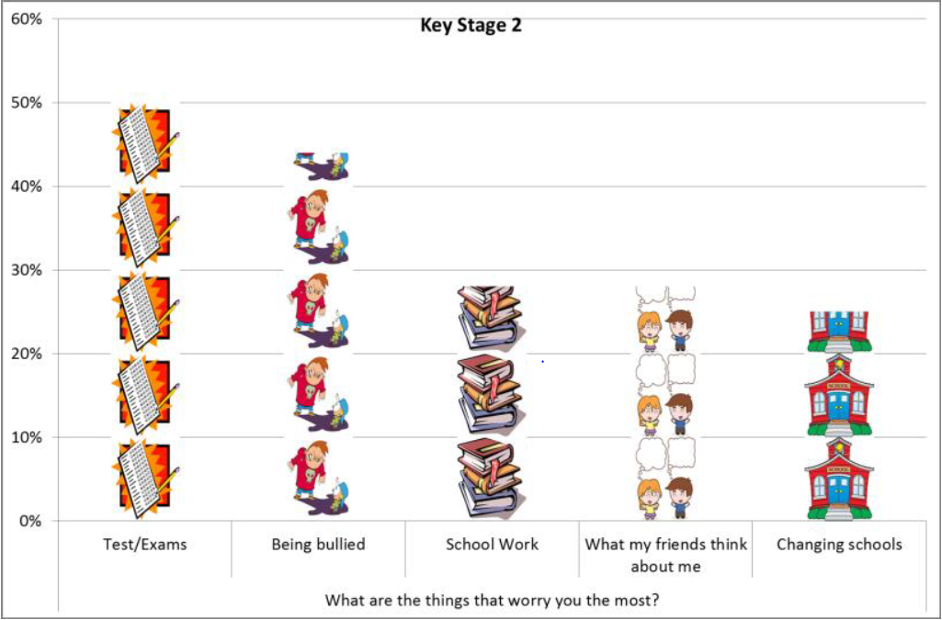

Bedford Borough – Emotional Wellbeing Survey (2014)
How we feel
94 % of pupils reported they were OK, Mostly or Very Happy most of the time.
7 to 11 year olds (Key Stage 2, KS2) were most likely to say they were Very or Mostly Happy (75%) compared to 68% of 11 to 14 year olds (KS3) and 55% of 14+ year olds (KS4).
Overall just under 6% of all pupils said they felt Sad or Very Sad most of the time.
5% of under 14 year olds (KS2 & KS3) reported they felt Sad or Very Sad most of the time, increasing to 10% of over 14 year olds (KS4).
Our Worries
Notes:
Bedford Borough carried out an emotional wellbeing survey in 2014. Results showed that 94% reported the were OK, Mostly or very happy most of the time. Although only 55% of 14+ year olds did.
6% of pupils said they felt sad or very sad most of the time. IN 14+ year olds this was 10%.
The main sources of worry were tests/ exams, being bullied, school work.

Slide 30
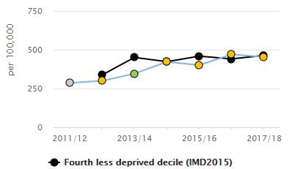
Hospital admissions for self-harm:
Trend in hospital admissions for self-harm (2011/12 to 2017/18 (10-24 year olds)
Per 100,000
Rates of self-harm are higher in the 15-19 age group – indicating the need for primary prevention in the younger age groups and secondary prevention in the older age groups
Admission rates have increased since 2011/12. Admissions rates are statistically similar to comparator local authorities for all age groups
But this is just the tip of the iceberg given the hidden nature of self-harm
Notes:
Data source: Fingertips data
Some individuals who are experiencing poor mental health self-harm. Rates of hospital admissions for self harm in Beds and CBC are similar to comparators. MK have a LIST service based at the hospital, which can see CYP and provide support without the need for admission. The result is that the admissions are lower compared with comparators. However, this is the tip of the iceburg, given the hidden nature of self-harm.

Slide 31
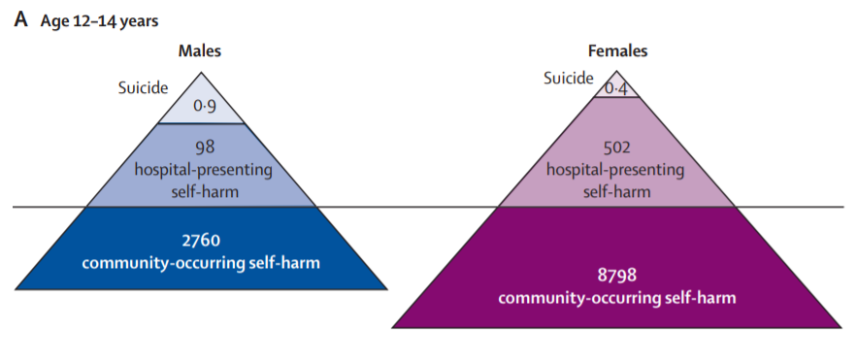
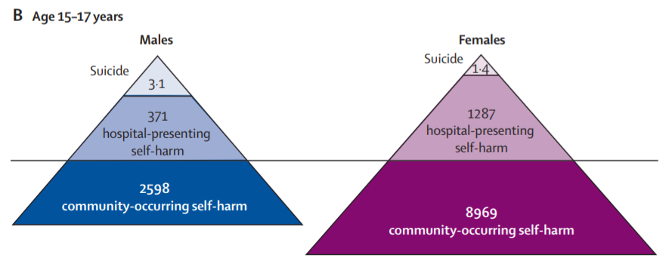
Estimating “hidden” community self harm
Figures A and B: Incidence of fatal and non-fatal self-harm per 100,000 person-years by age group and sex
Projected annual number of suicides and self-harm in children and young people aged 12 to 17 years in Bedford Borough based on national estimates
 | Bedford Borough
 | Males | Females | Total
Suicides | 0.13 | 0.05 | <1
Hospital-presenting self-harm | 15 | 52 | 67
Community self-harm (not to hospital) | 170 | 521 | 691
Notes:
Estimates of prevalence across the “self-harm iceberg” that represents the finding that for every case of completed suicide there are hundreds of hospital admissions and thousands of young people self-harming but not presenting to clinical services.

Slide 32
Protective factors: how are we performing?
Indicator | England | 4th least deprived decile | Bedford Borough | 95th Centile or Best in England
**% of children achieving a good level of development at the end of reception (17/18)⁶ | 71.5 | 72.6 | 69.6 | 77.0
**% of CYP with free school meal status achieving a good level of development at the end of reception (17/18)⁷ | 56.6 | 56.3 | 54.4 | 66.7
*Healthy weight in Reception children (%) (2017/18) ⁸ | 76.6 | - | 77.6 | 81.1
*Average Attainment 8 score for all pupils in state-funded schools (2017/18)⁹ | 46.7 |  | 45.5 | -
Key Points:
School readiness is a key indicator in ensuring children are developing well. In Bedford Borough the level of development is lower than comparators
The proportion of healthy weight in reception children is similar compared with the England average. 22.4% of children are not a healthy weight
Educational attainment at Key Stage 4 is comparatively lower
* RAG rated against England
** RAG rated against local authorities in same deprivation decile
Notes:
RAG ratings are made with comparators with areas in the same deprivation decile.
6: Source: DfE EYFS profile. Definition: Children defined as having reached a good level of development at the end of the Early Years Foundation Stage (EYFS) as a percentage of all eligible children.
7: Definition: Children with free school meal status defined as having reached a good level of development at the end of the EYFS as a percentage of all eligible children with free school meal status.
8: NCMP data for reception children
9: Definition: Average Attainment 8 score for all pupils in state-funded schools, based on local authority of school location. Influenced by quality of education, and socio-economic factors. Attainment 8 measures the achievement of a pupil across 8 qualifications including maths, English and sciences and history, geography, languages, etc.

Slide 33
Addressing adversity – how are we performing?
Indicator | England | 4th least deprived decile | Bedford Borough | 95th Centile or Best in England
**% CYP aged under 20 living in low income families (2016)¹⁰ | 17 | 15.1 | 14.8 | 9.2
**% of LAC 5-16yo where there is cause for concern (SDQ score >17) (16/17) ¹¹ | 38.1 | 40.1 | 45 | 21.6
**Children in need due to abuse or neglect (rate per 10,000 CYP <18) (2018) ¹² | 181 | 136.6 | 163 | 85.9
**CYP who started to be LAC due to abuse or neglect (rate per 10,000 <18) (2018) ¹³ | 16.4 | 13.5 | 15.6 | 6.5
**Family homelessness: rate per 1,000 households (2017/18) ¹⁴ | 1.7 | 1.8 | 2.5 | 0.3
Number of unaccompanied Asylum Seeking Children Looked After (2018) ¹⁵ | 600 | - | 19 | 6
Key Points:
Poverty indicators mask variation within areas
Adverse childhood experiences are a predictor of MH problems in children and young people and in adults.
In Bedford Borough family homelessness is an issue of concern with rates higher than similarly deprived areas.
BBC also has relatively high rates of CIN due to abuse or neglect compared with statistical neighbours
** RAG rated against local authorities in same deprivation decile
Notes:
Here are a number of indicators on addressing adversity in relation to risk factors relevant to mental health and wellbeing. In Bedford and MK, just under 15% of children are said to live in poverty. In CBC its 11%. For LAC, decile comparator data was not available. In Bedford 46% of LAC there is cause for concern. In BBC CBC there are high rates of CIN due to abuse or neglect. In MK, although it’s lower that comparators, we need to aim for a zero tolerance.
Family homelessness is high in Bedford and very high in Milton Keynes. Asylum seeking children are also a vulnerable group – data shown here are local numbers in 2018, with no comparison.
10: Source: HM Revenue and Customs (Personal Tax Credits: Related Statistics - Child Poverty Statistics). Definition: The percentage of dependent children aged under 20 in relative poverty (living in households where income is less than 60 per cent of median household income before housing costs).
11: Source: DfE. Definition: Proportion of all looked after children aged between 5 and 16 (inclusive) at the date of their latest assessment, who have been in care for at least 12 months on 31 March whose SDQ score was 17 or over.
12: Source: Children in Need statistics. Definition: Children identified as 'in need' on 31st March with abuse or neglect identified as the primary reason for being in need at initial assessment. The primary need indicates the main reason why a child started to receive services.
13: The number of children who started to be looked after due to abuse or neglect by local authorities during the year ending March 31st expressed as a rate per population aged 0-17.
14: Source: LA Child Health Profile; Definition: Applicant households eligible for assistance (1996 Housing Act) unintentionally homeless and in priority need (specific categories). Priority need categories of household includes dependent children or pregnant woman.
15: Definition: The number of unaccompanied asylum seeking children looked after.

Slide 34
Vulnerability
Indicator | England | 4th least deprived decile | Bedford | 95th Centile or Best in England
**Children in Care, rate per 10,000 <18 (2018)¹⁶ | 64 | 56 | 61 | 33
**Primary fixed period exclusions, rate per 100 pupils, state-funded schools (16/17)¹⁷ | 1.37 | 1.51 | 1.39 | 0.39
**Secondary fixed period exclusions, rate per 100 pupils, state-funded schools (16/17)¹⁸ | 9.4 | 8.4 | 5.5 | 4.5
**% of school aged pupils with a Learning Disability (2017)¹⁹ | 5.6 | 4.5 | 6.5 | 3.6
*% of 15 year olds who were bullied in last couple of months (14/15)²¹ | 55 | - | 52.3 | 48.3
**% 16-17 year olds not in education, employment or training, NEET (2017)²² | 6.0 | 5.2 | 5.1 | 2.3
**First time entrants into youth justice system,²³ rate per 100,000 population aged 10-17 (2018) | 293 | 196 | 194 | 152.3
Key Points:
These vulnerable groups are at increased risk of poor mental health
Exclusions: are there variations in how local data is recorded? How many children have partial timetables?
Bullying data available is old, data is held by individual schools, monitored by Ofsted.
* RAG rated against England
** RAG rated against local authorities in same deprivation decile
Notes:
16: Definition: Children looked after at 31 March (rate per 10,000 population aged under 18 years). Source: Department for Education (DfE)
17: The rate of fixed period exclusions per 100 pupils in state-funded primary schools. Source: DfE
18: The rate of fixed period exclusions per 100 pupils in state-funded secondary schools. Source: DfE
19: Definition: The number of primary, secondary and special school children who are identified as having a learning disability expressed as a percentage of all primary, secondary and special school pupils. DfE SEN statistics.
20: Percentage of 15 year olds who responded to questions on bullying in the WAY survey (2014/15)
21: The percentage of 15 year olds who responded to a number of questions in the What About YOUth survey and reported having undertaken at least 3 unhealthy/illegal behaviours. Source: WAY Survey 14/15
22: Proportion of 16-17 year olds not in education, employment or training (NEET) or whose activity is not known. DfE
23: Rate of 10-17 year olds receiving their first reprimand, warning or conviction per 100,000 population. Source: Criminal justice system statistics

Slide 35
Access to services
Bedford Borough

Slide 36
Examples of support for children and young people’s mental wellbeing include, but are not limited to:
Level of need | Examples of support available for children include, but are not limited to:
Universal | Primary Care universal support Voluntary sector providers Targeted Early Help team Universal Parenting Offer - Triple P Universal Children’s Centre Offer FACES – volunteer parent support | Child and Adolescent Mental Health (CAMH) School Programme in upper schools and colleges CHUMs programme in middle, lower and primary schools Whole school approach to mental health and wellbeing 0-19 services (School Nursing, Health Visiting) Peer mentoring pilot in schools Groundworks mentoring service
Additional Needs | 1:1 Solution Focus Brief Therapy Protective Behaviour 1:1 Support Enhanced Evidenced Based Practice Improving Access to Psychological Therapies (IAPT) CBT Intervention Targeted Parenting Offer | CAMH secondary school programme Families First Bedfordshire Play Therapy CHUMS Bedford Open Door 0-5 Infant Mental Health (IAPT) Trainees
Considerable Need | Child and Adolescent Mental Health Services (CAMHS) – commissioned by Bedfordshire Clinical Commissioning Group (CCG), provided by East London Foundation Trust (ELFT):
Specialist Need | Inpatient services; CAMHS Crisis Service and 16 plus Street Triage Service; Eating Disorder Service; Care, Education and Treatment Reviews (CETR)

Slide 37

Access to CAMHS – Bedford Borough (ELFT)
Ethnicity | %
White British | 49%
Ethnicity other than White British | 24%
Not known (missing) | 27%
Age (years) | % of referrals
0-4 | 4%
5-11 | 14%
12-18 | 81%
Key discussion points:
Slight increase in referrals 2017-18 (802)to 2018-19 (874)
Highest proportion of referrals from GPs in 18-19 (36%) followed by education establishments (25%), A&E (13%)
81% of children and young people referred were aged 12-18 years, 14% aged 5-11 years
98% of referrals were seen in 12 weeks or less
Children and Young People’s MH Access Target: 32% (ELFT contribution: 27%)
50%
50%
CCG | Prevalence Rate | CCG Trajectory for 2018-19 | Bedford Borough (ELFT) | Central Bedfordshire (ELFT | ELFT Total Contribution
Bedfordshire | 7,065 | 2,261 | 758 | 1,138 | 1,896
Notes:
Mention GP referrals, and other sources; number of referrals, ethnicity, majority

Slide 38
Central Bedfordshire Slides

Slide 39
Presenting the data and making comparisons
The performance of Central Bedfordshire is compared (RAG rated) with other areas in England within the same deprivation decile (10%) where available
  Central Bedfordshire is in the least deprived decile
Note: overall deprivation rating masks pockets of deprivation within areas
Different challenges arise in rural and urban areas
England data and 95th centile (best) data are also presented
Central Bedfordshire
Notes:
Where possible, RAG ratings have been made with other areas in England within the same deprivation decile – or 10%.

Slide 40
Do we understand the picture of mental wellbeing in our 0-5 year olds?
Nationally 5.5% of 2 – 4 year olds have a diagnosable MH condition (PHE, 2017).
The most common are neurodevelopment conditions, including ASD (out of scope)
Applied to local populations, that is
600 children in Central Bedfordshire
Are we identifying under 5s who need support and referring appropriately?
Are we picking this up early enough, e.g. through development checks, home visits, contact with other services?
What about those with low level needs?
Notes:
References:
https://digital.nhs.uk/data-and-information/publications/statistical/mental-health-of-children-and-young-people-in-england/2017/2017
Goldie, I., Elliott, I., Regan, M., Bernal, L., and Makurah, L. (2016) Mental health and prevention: Taking local action London: Mental Health Foundation
Burstow, P., Newbigging, K., Tew, J., and Costello, B., 2018. Investing in a Resilient Generation: Keys to a Mentally Prosperous Nation. Birmingham: University of Birmingham.
Local CAMHs referral data
Children aged 2-4: Milton Keynes: 11,901; 31 2-4yo were referred to CAMHs Oct17-Sept18 (0.26%)
BBC: 6,859
CBC: 10,903
National data indicates that 5.5% of children aged 2-4 have a diagnosable MH condition – the most prevalent were neurodevelopmental conditions. Locally children identified are referred to the community paediatrics service.
The evidence base for what works in the early years includes enhanced support during and after pregnancy for mothers, babies and families.; Intensive support for those who are experiencing difficulties.
Example programmes include … Preschool programmes which support school readiness, communication, social and emotional skills are also key. As is having local pathways which are NICE compliant.

Slide 41
The picture of mental wellbeing in school-aged children and young people
Indicator | England | Least deprived Decile | Central Bedfordshire | 95th Centile
% of Year 8, 10 and 12+ pupils with a low level of resilience (SHEU survey, 2017)¹ |  | - | 37% | -
*Mental Wellbeing in 15 year olds: Mean wellbeing (WEMWBS-14) score (14/15)*² | 47.6 | - | 47.1
*% of 15 year olds reporting positive satisfaction with life (14/15)*³ | 63.8 | - | 65.5 | 68.7
*% school pupils with identified social, emotional and MH needs (2018)⁴ | 2.39 |  | 2.47 | 1.65
Estimated % of MH disorders in CYP aged 5-16 (2015)⁵ | 9.2 | 8.1 | 8.4 | 8
**Hospital admissions for MH disorders per 100,000 population aged 0-17 yrs 17/18^{5a} | 84.7 | 90.4 | 87.9
Key Points:
Self reported levels of resilience were lower in CBC compared to the wider SHEU survey results
Prevalence of poor mental health is estimated and based on a national survey carried out in 2004.
Rates of hospital admissions for mental health related disorders similar to comparators
* RAG rated against England
** RAG rated against local authorities in same deprivation decile
Notes:
Central Bedfordshire participate in the bi-annual School Health and Education Unit survey. In 2017 37% reported low levels of resilience which is lower than the wider SHEU survey results. Bedford Borough did carry out an in-house EWB survey in 2014.
Within Bedford and Central Bedfordshire the School Nursing teams offer drop-in sessions in secondary schools, which young people can attend. In 2016/17 the School Nursing teams had 1,683 contacts with young people, of which 229 were self-harm related (13%). Of these, 202 were with girls, and 27 contacts with boys.
Data sources:
1 Results from 2017 SHEU survey, carried out with Year 4, 6, 10, 8 and 12+ pupils in central bedfordshire
2 Data source: What about YOUth survey (2014/15). The Warwick-Edinburgh Mental Wellbeing Scale (WEMWBS) is formed of 14 statements covering a range of feelings and attitudes towards life . Participants were asked to rate how often they felt like each of the 14 statements, ranging from ‘None of the time’ to ‘All of the time’, which are scored from 1 to 5. Each participant is given a single score based on their responses to the 14 statements which ranges from 14 – 70 (a sum of their scores to the individual statements).
3 The percentage of respondents scoring 7-10 to the question “Overall, how satisfied are you with your life nowadays” in the What About YOUth survey
4 Source: DfE. Definition: The number of school children who are identified as having social, emotional and mental health needs expressed as a percentage of all school pupils.
5 Definition: This is an estimate of the percentage of children aged 5-16 who have any mental health disorders based on the age, sex and socio-economic classification of children resident in the area. Based on 2004 survey data
5a: Inpatient data for codes First finished episodes for all persons aged 0 to 17 years with primary diagnosis codes F00 to F99 (Mental and behavioural disorders).

Slide 42
Results from the SHEU Health and Wellbeing Survey, CBC (2017)
Bullying:
28% of primary and 19% of secondary school pupils reported having been bullied at or near school in the last 12 months
40 % of primary school pupils were sometimes afraid to go to school because of bullying, and 11% were often or very often afraid
27% of secondary school pupils were sometimes afraid to go to school because of bullying, and 5% were often or very often afraid
Headlines – good news
Self-esteem scores higher in CBC than in the wider SHEU sample.
Happiness with life has increased for Yr6 pupils (2014 to 2017).
Headlines - not such good news
Lower measure of resilience in females than males across all year groups and worse than wider SHEU data for Year 6 to Year 10.
1/3 of older students not getting sufficient sleep to feel awake all day.
Pupils more likely to report a fear of bullying in 2017 than in 2014.
The proportion of pupils saying ‘school encourages me to be physically active’ is lower in 2017 than in 2014.
Over 40% of Year 10 pupils said they would go to no one/nowhere if they wanted help or information about their sexuality or gender.
Notes:
Reference: School Health Education Unit – Health and Wellbeing Survey 2017.
Here are some headline results from the CBC SHEU survey – fear of bullying has increased since 2014, with 40% of primary school pupils sometimes afraid to go to school because of bullying. Bullying is a significant factor affecting mental wellbeing.

Slide 43
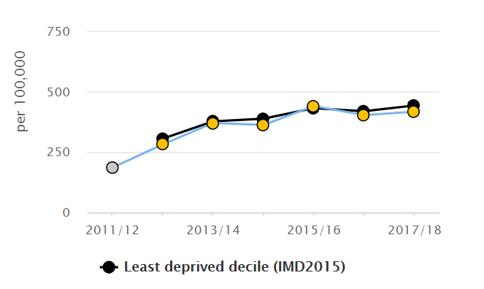
Self-harm:
Trend in hospital admissions for self-harm (2011/12 to 2017/18) in 10-24 year olds
Admissions as a result of self-harm are similar comparators for all age group. Admission rates have increased between 2011/12 to 2017/18
Rates of self harm are higher in the 15-19 age group – indicating the need for primary prevention in the younger age groups and secondary prevention in the older age groups
But this is just the tip of the iceberg given the hidden nature of self-harm
Notes:
Data source: Fingertips data
Some individuals who are experiencing poor mental health self-harm. Rates of hospital admissions for self harm in Beds and CBC are similar to comparators. MK have a LIST service based at the hospital, which can see CYP and provide support without the need for admission. The result is that the admissions are lower compared with comparators. However, this is the tip of the ice burg, given the hidden nature of self-harm.

Slide 44
Protective factors: how are we performing?
Key Points:
School readiness is a key indicator in ensuring children are developing well. In CBC, the proportion achieving a good level of development at the end of reception (73.2%) is lower than comparators, and for those who are eligible for FSM which is only 44.2%.
This proportion of healthy weight in reception children is better than comparators in CBC (80%) compared with the England average. However there is still at lease 20% of children who are not a healthy weight.
Education attainment at Key Stage 4 is comparatively lower (46.2)
Indicator | England | Least deprived decile | Central Bedfordshire | 95th Centile or Best in England
**% of children achieving a good level of development at the end of reception (17/18)⁶ | 71.5 | 75.4 | 73.2 | 77
**% of CYP with FSM status achieving a good level of development at the end of reception (17/18)⁷ | 56.6 | 52.8 | 44.2 | 66.7
*Healthy weight in Reception children (%) (17/18) ⁸ | 76.6 | - | 80 | 81.1
*Average Attainment 8 score for all pupils in state-funded schools (17/18)⁹ | 57.8 | - | 46.2 | -
* RAG rated against England
** RAG rated against local authorities in same deprivation decile
Notes:
RAG ratings are made with comparators with areas in the same deprivation decile. So for CBC, although they have a higher proportion of children achiving a good level of development at the end of reception than Bedford Borough, compared with similar areas, they aren’t performing so well. Then read through key points.
6: Source: DfE EYFS profile. Definition: Children defined as having reached a good level of development at the end of the Early Years Foundation Stage (EYFS) as a percentage of all eligible children.
7: Definition: Children with free school meal status defined as having reached a good level of development at the end of the EYFS as a percentage of all eligible children with free school meal status.
8: NCMP data for reception children
9: Definition: Average Attainment 8 score for all pupils in state-funded schools, based on local authority of school location. Influenced by quality of education, and socio-economic factors. Attainment 8 measures the achievement of a pupil across 8 qualifications including maths, English and sciences and history, geography, languages, etc.

Slide 45
Addressing adversity – how are we performing?
Indicator | England | Least deprived decile | Central Bedfordshire | 95th Centile or Best in England
**% CYP aged under 20 living in low income families (2016)¹⁰ | 17 | 9.9 | 11 | 9.2
**% of LAC 5-16yo where there is cause for concern (SDQ score >17) (16/17) ¹¹ | 38.1 |  | 34.8 | 21.6
**Children in need due to abuse or neglect (rate per 10,000 CYP <18) (2018) ¹² | 181 | 95.6 | 119 | 85.9
**CYP who started to be LAC due to abuse or neglect (rate per 10,000 <18) (2018) ¹³ | 16.4 | 8.3 | 10.4 | 6.5
**Family homelessness: rate per 1,000 households (2017/18) ¹⁴ | 1.7 | 1.1 | 1.0 | 0.3
Number of unaccompanied Asylum Seeking Children Looked After (2018) ¹⁵ | 4480 | 550 | 39 | 6
Key Points:
Poverty indicators mask variation within areas
Adverse childhood experiences are a predictor of MH problems in CYP and in adults.
CBC has relatively high rates of CIN due to abuse or neglect
** RAG rated against local authorities in same deprivation decile
Notes:
Here are a number of indicators on addressing adversity in relation to risk factors relevant to mental health and wellbeing. In Bedford and MK, just under 15% of children are said to live in poverty. In CBC its 11%. For LAC, declide comparator data was not available. In Bedford 46% of LAC there is cause for concern. In BBC, CBC there are high rates of CIN due to abuse or neglect. In MK, although it’s lower that comparators, we need to aim for a zero tolerance. Family homelessness is high in Bedford and very high in Milton Keynes. Asylum seeking children are also a vulnerable group – data shown here are local numbers in 2018, with no comparison.
10: Source: HM Revenue and Customs (Personal Tax Credits: Related Statistics - Child Poverty Statistics). Definition: The percentage of dependent children aged under 20 in relative poverty (living in households where income is less than 60 per cent of median household income before housing costs).
11: Source: DfE. Definition: Proportion of all looked after children aged between 5 and 16 (inclusive) at the date of their latest assessment, who have been in care for at least 12 months on 31 March whose SDQ score was 17 or over.
12: Source: Children in Need statistics. Definition: Children identified as 'in need' on 31st March with abuse or neglect identified as the primary reason for being in need at initial assessment. The primary need indicates the main reason why a child started to receive services.
13: The number of children who started to be looked after due to abuse or neglect by local authorities during the year ending March 31st expressed as a rate per population aged 0-17.
14: Source: LA Child Health Profile; Definition: Applicant households eligible for assistance (1996 Housing Act) unintentionally homeless and in priority need (specific categories). Priority need categories of household includes dependent children or pregnant woman.
15: Definition: The number of unaccompanied asylum seeking children looked after.

Slide 46
Vulnerability
Indicator | England | Least Deprived Decile | Central Bedfordshire | 95th Centile or Best in England
**Children in Care, rate per 10,000 <18 (2018)¹⁶ | 64 | 41 | 51 | 33
**Primary fixed period exclusions, rate per 100 pupils, state-funded schools (16/17)¹⁷ | 1.37 | 1.54 | 1.93 | 0.39
**Secondary fixed period exclusions, rate per 100 pupils, state-funded schools (16/17)¹⁸ | 9.4 | 7.1 | 6.1 | 4.5
**% of school aged pupils with a Learning Disability (2017)¹⁹ | 5.6 | 5.6 | 5.4 | 3.6
*% of 15 year olds who were bullied in last couple of months (14/15)²¹ | 55 | - | 52.1 | 48.3
**% 16-17 year olds not in education, employment or training, NEET (2017)²² | 6.0 | 5.5 | 6.6 | 2.3
**First time entrants into youth justice system,²³ rate per 100,000 population aged 10-17 (2018) | 293 | 158.4 | 98.1 | 152.3
Key Points:
These vulnerable groups are at increased risk of poor mental health
Exclusions: are there variations in how local data is recorded? How many children have partial timetables?
Bullying data is old, data is held by individual schools, monitored by Ofsted. CBC have more current data, from SHEU survey
* RAG rated against England
** RAG rated against local authorities in same deprivation decile
Notes:
16: Definition: Children looked after at 31 March (rate per 10,000 population aged under 18 years). Source: Department for Education (DfE)
17: The rate of fixed period exclusions per 100 pupils in state-funded primary schools. Source: DfE
18: The rate of fixed period exclusions per 100 pupils in state-funded secondary schools. Source: DfE
19: Definition: The number of primary, secondary and special school children who are identified as having a learning disability expressed as a percentage of all primary, secondary and special school pupils. DfE SEN statistics.
20: Percentage of 15 year olds who responded to questions on bullying in the the WAY survey (2014/15)
21: The percentage of 15 year olds who responded to a number of questions in the What About YOUth survey and reported having undertaken at least 3 unhealthy/illegal behaviours. Source: WAY Survey 14/15
22: Proportion of 16-17 year olds not in education, employment or training (NEET) or whose activity is not known. DfE
23: Rate of 10-17 year olds receiving their first reprimand, warning or conviction per 100,000 population. Source: Criminal justice system statistics

Slide 47
Access to services
Central Bedfordshire

Slide 48
Examples of support for children and young people’s mental wellbeing include, but are not limited to:
Level of need | Examples of support available for children include, but are not limited to:
Universal | Primary Care universal support Voluntary sector providers Targeted Early Help team Universal Parenting Offer - Triple P Universal Children’s Centre Offer FACES – volunteer parent support | Child and Adolescent Mental Health (CAMH) School Programme in upper schools and colleges CHUMs programme in middle, lower and primary schools Whole school approach to mental health and wellbeing 0-19 services (School Nursing, Health Visiting) Peer mentoring pilot in schools Groundworks mentoring service
Additional Needs | 1:1 Solution Focus Brief Therapy Protective Behaviour 1:1 Support Enhanced Evidenced Based Practice Improving Access to Psychological Therapies (IAPT) CBT Intervention Targeted Parenting Offer | CAMH secondary school programme Families First Bedfordshire Play Therapy CHUMS Bedford Open Door 0-5 Infant Mental Health (IAPT) Trainees
Considerable Need | Child and Adolescent Mental Health Services (CAMHS) – commissioned by Bedfordshire Clinical Commissioning Group (CCG), provided by East London Foundation Trust (ELFT):
Specialist Need | Inpatient services; CAMHS Crisis Service and 16 plus Street Triage Service; Eating Disorder Service; Care, Education and Treatment Reviews (CETR)

Slide 49
Access to CAMHs – Central Bedfordshire (ELFT)
Ethnicity | %
White British | 62%
Ethnicity other than White British | 7%
Not known (not asked) | 31%
Age (years) | % of referrals
0-4 | 1%
5-11 | 19%
12-18 | 80%
Key discussion points:
Similar number of referrals in 17-18 (2,081) and 18-19 (2,186)
Highest proportion of referrals from GPs in 18-19 (45%) followed by education establishments (15%), A&E (12%)
80% of CYP referred were aged 12-18 years, 19% aged 5-11 years
98% of referrals were seen 12 weeks or less
54%
46%
CYPMH Access Rate: 32% (ELF contribution: 27%)
CCG | Prevalence Rate | CCG Trajectory for 2018-19 | Bedford Borough (ELFT) | Central Bedfordshire (ELFT | ELFT Total Contribution
Bedfordshire | 7065 | 2261 | 758 | 1138 | 1896

Slide 50
Recommendations: Bedford Borough and Central Bedfordshire

Slide 51
 | RECOMMENDATIONS FOR THE SYSTEM
SY1 | Mental health literacy needs to continue to be improved across the system, including raising awareness and breaking the stigma. Professionals from across the system including front line staff should be encouraged to access training and professional development opportunities, with a particular focus on those working with vulnerable children and young people.
SY2B | Targeted prevention and early intervention for individuals at increased risk of poor mental health should remain a priority for the system, and this support should include a focus on early years and lower/primary schools.
SY3 | There needs to be up to date and easily accessible information for children, young people and their families as well as health, education and care professionals on how to promote mental wellbeing and how to access support if needed.
SY4 | Opportunities for peer support for children, young people and their families should be expanded in schools and community settings.

Slide 52
 | RECOMMENDATIONS FOR THE SYSTEM CONTINUED
SY5 | Ensure the forthcoming Mental Health School Team is fully aligned to the existing CAMHS School Teams, and compliments the existing pathways and relationships, including with the school nursing teams.
SY6B | Ensuring those nearing their 18th birthday receive the appropriate support and achieve good outcomes should continue to be a shared priority. Actions to support this include: working towards a flexible 0-25 pathway for mental health support sharing learning from transition evaluations, including outcomes and the experiences of young people and involving them in decision making strengthening flexible, multi-agency working through joint commissioning and improved use of the “all about me” document.
SY7 | We need to get better at demonstrating that the voice of CYP is heard and that action has been taken to improve access to support for mental health and wellbeing

Slide 53
 | RECOMMENDATIONS FOR SCHOOLS AND COLLEGES
SC1 | Schools and colleges should continue to build pupil resilience through whole school approaches to mental wellbeing, including promoting teaching staff wellbeing. Where schools and colleges are not engaging with the local support and services that are available, this should be identified and addressed.
SC2 | Schools and colleges should evaluate whether current anti-bullying policies and approaches (including measures to address online bullying) are effective and in line with evidence based practice.

Slide 54
RECOMMENDATIONS FOR CHILD & ADOLESCENT MENTAL HEALTH SERVICES
CA1 | There should be an audit of referrals to Child and Adolescent Mental Health Services (CAMHS) that are not seen by CAMHS but are signposted to alternative support. The audit should assess the effectiveness of signposting. The results of the audit should form the basis of agreed actions and processes to ensure that those not meeting CAMHS thresholds have timely access to appropriate support.
CA2B | The impact of targeted training delivered by ELFT aimed at improving quality of referrals should be reviewed. Referral sources and rates of inappropriate and signposted referrals should be reported to BCCG to monitor and assess improvement.
CA3B | The data reported by East London NHS Foundation Trust (ELFT, the CAMHS provider) to Bedfordshire Clinical Commissioning Group (BCCG) should be developed to include reporting of referral reasons, and confirmed diagnosis / nature of caseloads. More transparent reporting of waiting times is needed, including internal waiting times.

Slide 55
Milton Keynes Data Only Slides

Slide 56
Presenting the data and making comparisons
The following performance data is presented for a number or relevant indicators:
  Milton Keynes
  England
  Data for local authorities in the 4th least deprived decile in England, which includes Milton Keynes
  Data for local authorities with the best performance for each indicator (95th centile)
Milton Keynes data is compared (RAG) to the average of other areas in England within the same deprivation decile (4th least deprived) where available.
Where unavailable, comparisons are made to England data
Milton Keynes
Notes:
Given the geographical areas covered by this needs assessment, I though it would be helpful to give some context as to how the data comparisons and RAG ratings are made within the presentation. Firstly where possible, RAG ratings have been made with other areas in England within the same deprivation decile – or 10%.

Slide 57
The picture of mental wellbeing in school-aged children and young people
Indicator | England | 4th least deprived decile | Milton Keynes | 95th Centile
*Mental Wellbeing in 15 year olds: Mean wellbeing (WEMWBS-14) score (14/15)*² | 47.6 | - | 45.4
*% of 15 year olds reporting positive satisfaction with life (14/15)*³ | 63.8 | - | 59.7 | 68.7
*% school pupils with identified social, emotional and MH needs (2018)⁴ | 2.39 |  | 2.06 | 1.65
Estimated % of MH disorders in CYP aged 5-16 (2015)⁵ | 9.2 | 9.0 | 9.0 | 8
**Hospital admissions for MH disorders per 100,000 population aged 0-17 yrs 17/18^{5a} | 84.7 | 83.6 | 42.9
Key Points:
Current data on the wellbeing if young people in Milton Keynes is lacking – data from 2014/15 indicates low wellbeing and positive satisfaction with life scores in CYP in MK
School pupils in MK have significantly lower rates of identified social, emotional and mental health needs than comparator local authorities.
Prevalence of poor mental health is estimated and based on a national survey carried out in 2004.
Rates of hospital admissions for MH are lower in MK than comparator LAs. Potentially due to Liaison and Intensive Support Team based at MK hospital
* RAG rated against England
** RAG rated against local authorities in same deprivation decile
Notes:
MK do not currently have a school survey.
Central Bedfordshire participate in the bi-annual School Health and Education Unit survey. In 2017 37% reported low levels of resilience which is lower than the wider SHEU survey results. Bedford Borough did carry out an in-house EWB survey in 2014.
Within Bedford and Central Bedfordshire the School Nursing teams offer drop-in sessions in secondary schools, which young people can attend. In 2016/17 the School Nursing teams had 1,683 contacts with young people, of which 229 were self-harm related (13%). Of these, 202 were with girls, and 27 contacts with boys.
Data sources:
1 Results from 2017 SHEU survey, carried out with Year 4, 6, 10, 8 and 12+ pupils in central bedfordshire
2 Data source: What about YOUth survey (2014/15). The Warwick-Edinburgh Mental Wellbeing Scale (WEMWBS) is formed of 14 statements covering a range of feelings and attitudes towards life . Participants were asked to rate how often they felt like each of the 14 statements, ranging from ‘None of the time’ to ‘All of the time’, which are scored from 1 to 5. Each participant is given a single score based on their responses to the 14 statements which ranges from 14 – 70 (a sum of their scores to the individual statements).
3 The percentage of respondents scoring 7-10 to the question “Overall, how satisfied are you with your life nowadays” in the What About YOUth survey
4 Source: DfE. Definition: The number of school children who are identified as having social, emotional and mental health needs expressed as a percentage of all school pupils.
5 Definition: This is an estimate of the percentage of children aged 5-16 who have any mental health disorders based on the age, sex and socio-economic classification of children resident in the area. Based on 2004 survey data
5a: Inpatient data for codes First finished episodes for all persons aged 0 to 17 years with primary diagnosis codes F00 to F99 (Mental and behavioural disorders).

Slide 58
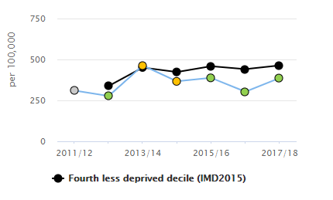
Hospital admissions for self-harm:
Trend in hospital admissions for self-harm (2011/12 to 2017/18) in 10-24 year olds
Hospital admissions as a result of self-harm in Milton Keynes are lower than comparator LAs. Local rates may be as a result of a 24hr Liaison and Intensive Support Team (LIST) based at MK hospital which saw over 400 patients in 18-19, which supported YP without the need for admission
Rates of self harm are higher in the 15-19 age group – indicating the need for primary prevention in the younger age groups and secondary prevention in the older age groups
But this is just the tip of the iceberg given the hidden nature of self-harm
Notes:
Data source: Fingertips data
Some individuals who are experiencing poor mental health self-harm. Rates of hospital admissions for self harm in Beds and CBC are similar to comparators. MK have a LIST service based at at the hospital, which can see CYP and provide support withouth the need for admission. The result is that the admissions are lower compared with comparators. However, this is the tip of the ice burg, given the hidden nature of self-harm. Marianne is leading on the self-harm work and has data on estimated prevalence of self harm in the community if you would like more information.

Slide 59
Estimating “hidden” community self harm
0
Suicide
84
Hospital admissions for self harm
841
Unreported self harm
<1
Suicide
23
Hospital admissions for SH
264
Unreported self harm
Females
Males
Projection of study figures for suicide and self-harm in MK (approximate annual number of individuals aged 12-17)
Ages 12-17 | Milton Keynes
Numbers | Males | Females | Total
Suicides | <1 | <1 | <1
Hospital-presenting SH | 23 | 84 | 107
Community SH (not to hospital) | 264 | 841 | 1105
Notes:
Estimates of prevalence across the “self-harm iceberg” that represents the finding that for every case of completed suicide there are hundreds of hospital admissions and thousands of young people self-harming but not presenting to clinical services.

Slide 60
Protective factors: how are we performing?
Key Points:
Protective factors for mental wellbeing include school readiness, healthy weight and education attainment.
Milton Keynes are performing at a similar level to comparator LAs for these indicators.
However there is still room for improvement, and efforts should continue to improve outcomes particularly for the most vulnerable groups
Indicator | England | 4th least deprived decile | Milton Keynes | 95th Centile or Best in England
**% of children achieving a good level of development at the end of reception (17/18)⁶ | 71.5 | 72.6 | 73.3 | 77
**% of CYP with FSM status achieving a good level of development at the end of reception (17/18)⁷ | 56.6 | 56.3 | 60.2 | 66.7
*Healthy weight in Reception children (%) (17/18) ⁸ | 76.6 | - | 76.2 | 81.1
*Average Attainment 8 score for all pupils in state-funded schools (17/18)⁹ | 57.8 |  | 46.2 | -
* RAG rated against England
** RAG rated against local authorities in same deprivation decile
Notes:
RAG ratings are made with comparators with areas in the same deprivation decile.
6: Source: DfE EYFS profile. Definition: Children defined as having reached a good level of development at the end of the Early Years Foundation Stage (EYFS) as a percentage of all eligible children.
7: Definition: Children with free school meal status defined as having reached a good level of development at the end of the EYFS as a percentage of all eligible children with free school meal status.
8: NCMP data for reception children
9: Definition: Average Attainment 8 score for all pupils in state-funded schools, based on local authority of school location. Influenced by quality of education, and socio-economic factors. Attainment 8 measures the achievement of a pupil across 8 qualifications including maths, English and sciences and history, geography, languages, etc.

Slide 61
Addressing adversity – how are we performing?
Indicator | England | 4th least deprived decile | Milton Keynes | 95th Centile or Best in England
**% CYP aged under 20 living in poverty (2016)¹⁰ | 17 | 15.1 | 14.9 | 9.2
**% of LAC 5-16yo where there is cause for concern (SDQ score >17) (16/17) ¹¹ | 38.1 | 40.1 | 39.1 | 21.6
**Children in need due to abuse or neglect (rate per 10,000 CYP <18) (2018) ¹² | 181 | 136.6 | 100 | 85.9
**CYP who started to be LAC due to abuse or neglect (rate per 10,000 <18) (2018) ¹³ | 16.4 | 13.5 | 10.6 | 6.5
**Family homelessness: rate per 1,000 households (2017/18) ¹⁴ | 1.7 | 1.8 | 5.0 | 0.3
Number of unaccompanied Asylum Seeking Children Looked After (2018) ¹⁵ | 600 | - | 26 | 6
Key Points:
Poverty indicators mask variation within areas
Adverse childhood experiences are a predictor of MH problems in CYP and in adults.
In Milton Keynes, family homelessness is an issue of concern with rates higher than similarly deprived areas.
** RAG rated against local authorities in same deprivation decile
Indicates that performance is better than comparators
Notes:
Here are a number of indicators on addressing adversity in relation to risk factors relevant to mental health and wellbeing. In Bedford and MK, just under 15% of children are said to live in poverty. In CBC its 11%. For LAC, decile comparator data was not available. In Bedford 46% of LAC there is cause for concern. In BBC CBC there are high rates of CIN due to abuse or neglect. In MK, although it’s lower that comparators, we need to aim for a zero tolerance. Family homelessness is high in Bedford and very high in Milton Keynes. Asylum seeking children are also a vulnerable group – data shown here are local numbers in 2018, with no comparison.
10: Source: HM Revenue and Customs (Personal Tax Credits: Related Statistics - Child Poverty Statistics). Definition: The percentage of dependent children aged under 20 in relative poverty (living in households where income is less than 60 per cent of median household income before housing costs).
11: Source: DfE. Definition: Proportion of all looked after children aged between 5 and 16 (inclusive) at the date of their latest assessment, who have been in care for at least 12 months on 31 March whose SDQ score was 17 or over.
12: Source: Children in Need statistics. Definition: Children identified as 'in need' on 31st March with abuse or neglect identified as the primary reason for being in need at initial assessment. The primary need indicates the main reason why a child started to receive services.
13: The number of children who started to be looked after due to abuse or neglect by local authorities during the year ending March 31st expressed as a rate per population aged 0-17.
14: Source: LA Child Health Profile; Definition: Applicant households eligible for assistance (1996 Housing Act) unintentionally homeless and in priority need (specific categories). Priority need categories of household includes dependent children or pregnant woman.
15: Definition: The number of unaccompanied asylum seeking children looked after.

Slide 62
Vulnerability
Indicator | England | 4th least deprived decile | Milton Keynes | 95th Centile or Best in England
**Children in Care, rate per 10,000 <18 (2018)¹⁶ | 64 | 56 | 58 | 33
**Primary fixed period exclusions, rate per 100 pupils, state-funded schools (16/17)¹⁷ | 1.37 | 1.51 | 1.55 | 0.39
**Secondary fixed period exclusions, rate per 100 pupils, state-funded schools (16/17)¹⁸ | 9.4 | 8.4 | 9.0 | 4.5
**% of school aged pupils with a Learning Disability (2017)¹⁹ | 5.6 | 4.5 | 5.9 | 3.6
*% of 15 year olds who were bullied in last couple of months (14/15)²¹ | 55 | - | 59.4 | 48.3
**% 16-17 year olds not in education, employment or training, NEET (2017)²² | 6.0 | 5.2 | 4.6 | 2.3
**First time entrants into youth justice system,²³ rate per 100,000 population aged 10-17 (2018) | 293 | 196 | 255 | 152.3
Key Points:
These vulnerable groups are at increased risk of poor mental health
Exclusions: are there variations in how local data is recorded? How many children have partial timetables?
Bullying data is old, data is held by individual schools, monitored by Ofsted.
* RAG rated against England
** RAG rated against local authorities in same deprivation decile
Notes:
16: Definition: Children looked after at 31 March (rate per 10,000 population aged under 18 years). Source: Department for Education (DfE)
17: The rate of fixed period exclusions per 100 pupils in state-funded primary schools. Source: DfE
18: The rate of fixed period exclusions per 100 pupils in state-funded secondary schools. Source: DfE
19: Definition: The number of primary, secondary and special school children who are identified as having a learning disability expressed as a percentage of all primary, secondary and special school pupils. DfE SEN statistics.
20: Percentage of 15 year olds who responded to questions on bullying in the the WAY survey (2014/15)
21: The percentage of 15 year olds who responded to a number of questions in the What About YOUth survey and reported having undertaken at least 3 unhealthy/illegal behaviours. Source: WAY Survey 14/15
22: Proportion of 16-17 year olds not in education, employment or training (NEET) or whose activity is not known. DfE
23: Rate of 10-17 year olds receiving their first reprimand, warning or conviction per 100,000 population. Source: Criminal justice system statistics

Slide 63
Access to services
Milton Keynes

Slide 64
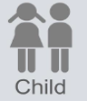



Examples of approaches in Milton Keynes to promoting protective factors
Level | Example approaches | Potential gaps/ risks
Breastfeeding initiatives
0-19 services (Health Visiting and School Nursing
Family Centre Offer
MH Practitioner in teams working with vulnerable groups e.g. Early Help; Youth Offending
Voluntary Sector Providers
Ranges from counselling to family support, support for victims of crime, wellbeing, housing, Drug and Alcohol, and many more
Early Identification of need
High thresholds for services
Targeted support for high risk
Unstable funding for a number of initiatives including voluntary sector initiatives; Early help services
Limited capacity in 0-19 service for low level MH support
Support for CYP with parental MH
Parenting programmes
MH in schools and colleges program
Supporting mental health of school staff
MH training for school staff and governors
Variable School based support
Home schooled CYP
Healthy Young Peoples Network
CCG-led self-care groups
Lakes Estate Community led programme
Sport and leisure provision
Potential for more asset based/ community led initiatives
Notes:
The Bedford and Central Bedfordshire School Nursing Service also reported that nearly 50% of the young people attending school drop-ins are presenting with issues around emotional wellbeing and anxiety (2015/16).
The results of the 2014 Bedford Borough schools’ Emotional Wellbeing survey tells us that most children and young people are happy most of the time; however, the percentage of pupils who reported feeling sad was higher in those over 14 years of age.
MK does not currently have a school survey

Slide 65
Example approaches in Milton Keynes to addressing risk factors
Level | Example approaches | Potential gaps/ risks
Development Checks – HV ad SN
Co-location of MH workers with vulnerable groups e.g. YOT, LAC, MASH
Domestic Abuse Strategy / Needs Assessments and support services
Safeguarding procedures and policies
Drug and alcohol services
Times of transition e.g.
Primary-secondary school
Secondary to higher education
School to employment
CAMHs to Adult MH services
Support for vulnerable groups:
CYP with family in prison
young carers – identification, funding for support
CYP affected by or at risk of homelessness
Potential to improve identification of ACEs for early intervention and targeted support
No commissioned trauma / emotional wellbeing support. Rely on over-stretched voluntary provision e.g. Samaritans
Anti-bullying policies
Safeguarding and MH audit
Peer support programmes

Slide 66
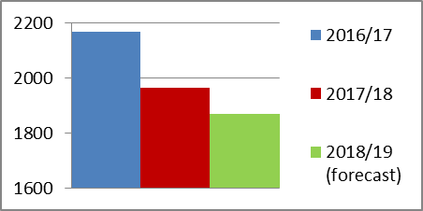
Access to Child and Adolescent Mental Health Services (CAMHs) – Provided by Central and North West London NHS Foundation Trust (CNWL)
Referral sources (Oct17-Sep17) | % of total referrals | % not accepted
GPs | 58 | 66
Education establishments | 8 | No data
Acute trust | 7 | No data
Carer | 7 | No data
Total referrals not accepted: 39%
Referrals 2016 - 2019
Ethnicity MK | %
British | 38%
Ethnicity other than British | 16%
Not known/ not stated | 45%
Age (years) | % of referrals
0-4 | 2%
5-10 | 33%
11-16 | 58%
17-19 | 8%
Key points:
Number of referrals decreasing since 2016/17 – but rates of poor mental health are increasing nationally
Majority of referrals from GPs (58%) followed by education (8%), acute trust 1 hr response (7%) & carer (7%)
39% referrals not accepted (Oct17-Sep18)
58% of referrals were aged 11 – 16 years, 33% aged 5 – 10 years
51%
49%
Notes:
Mk has a higher proportion (43.8%) of school children from minority ethnic groups

Slide 67
CAMHs referral reasons - data from Milton Keynes CAMHs only (Oct17-Sep18), data not available from ELFT
NDCs = Neurodevelopment conditions
PTSD = Post Traumatic Stress Disorder
Notes:
Other includes: Phobia, Self - care issues, Suspected Autism Spectrum Disorder, Diagnosed Autism Spectrum Disorder, Drug and alcohol difficulties, Personality disorders, Unexplained physical symptoms, Bipolar Disorder
Helpful to understand the referrals that are not accepted, as it can inform the nature of support required outside of CAMHS for those who are experiencing these issues.

Slide 68
Key points for discussion – CAMHs access
GPs providing majority of referrals in all three areas, however there is a high proportion of referrals not accepted
Lack of ethnicity data for CAMHs referrals (often not provided), but it appears that ethnic minorities are under represented in CAMHs
Average waiting time targets (referral to assessment) are being met
Waiting time from referral to treatment is unclear – this is a national challenge
Referrals not accepted are signposted by CAMHs to alternative support – do we have the right support available? The data on referral reasons not accepted may help to inform the support needed.
Notes:
Lack of ethnicity data recorded for CAMHs referrals, but it appears that ethnic minorities are under represented in CAMHs
ELFT are undertaking a Quality Improvement project to address this

Slide 69
Recommendations: Milton Keynes

Slide 70
 | RECOMMENDATIONS FOR THE SYSTEM
SY1 | Mental health literacy needs to continue to be improved across the system, including raising awareness and breaking the stigma. Professionals from across the system including front line staff should be encouraged to access training and professional development opportunities, with a particular focus on those working with vulnerable children and young people.
SY2MK | Further work is needed to understand and address the gaps in low level support, including how to better manage low level need to prevent needs escalating and reduce demand on specialist services. This includes identifying how we better align Universal services, Early Help and the Primary Care Front Door.
SY3 | There needs to be up to date and easily accessible information for children, young people and their families as well as health, education and care professionals on how to promote mental wellbeing and how to access support if needed.
SY4 | Opportunities for peer support for children, young people and their families should be expanded in schools and community settings.

Slide 71
 | RECOMMENDATIONS FOR THE SYSTEM CONTINUED
SY5 MK | Ensure the forthcoming Mental Health School Team compliments the existing pathways and relationships, including with the school nursing teams.
SY6MK | Ensuring those nearing their 18th birthday receive the appropriate support and achieve good outcomes should continue to be a shared priority. We need to: work towards a flexible 0-25 pathway for mental health support Ensure care and support provided to YP is appropriate to their level of understanding and life circumstances and that commissioned service contracts have the flexibility to enable this strengthening flexible, multi-agency working through joint commissioning and improved use of the “all about me” document. Review changes that have been made based on the voice of young people who have transitions from children’s to adult services, and where action still needs to be taken.
SY7 | We need to get better at demonstrating that the voice of CYP is heard and that action has been taken to improve access to support for mental health and wellbeing
SY8MK | A whole systems framework (e.g. i-Thrive) should be developed which clearly identifies where system partners fit into the support pathway.

Slide 72
 | RECOMMENDATIONS FOR SCHOOLS AND COLLEGES
SC1 | Schools and colleges should continue to build pupil resilience through whole school approaches to mental wellbeing, including promoting teaching staff wellbeing. Where schools and colleges are not engaging with the local support and services that are available, this should be identified and addressed.
SC2 | Bullying is a risk factor for poor mental health. Schools and colleges should evaluate whether current anti-bullying policies and approaches (including measures to address online bullying) are effective and in line with evidence based practice.
SC3MK | Options should be identified and agreed to provide robust data on prevalence and trends of bullying, resilience and wellbeing in children and young people

Slide 73
RECOMMENDATIONS FOR CHILD & ADOLESCENT MENTAL HEALTH SERVICES
CA1 | There should be an audit of referrals to Child and Adolescent Mental Health Services (CAMHS) that are not seen by CAMHS but are not accepted and/ or signposted to alternative support. The audit should assess the effectiveness of signposting. The results of the audit should form the basis of agreed actions and processes to ensure that those not meeting CAMHS thresholds have timely access to appropriate support.
CA2MK | Improving quality of referrals: engage with primary care to understand what they need to manage mild to moderate mental health conditions in children and young people, as well as when and how to make an effective referral to CAMHs. Work with schools to understand what they need to improve effectiveness of referrals.
CA3MK | The CCG needs to request more transparent reporting of waiting times from referral to assessment and referral to treatment – including the range in addition to average waiting time.
CA4MK | CAMHs service user engagement should be strengthened, to improve how we listen to and respond to the voice of young people in relation to service design and delivery.

Slide 74
Bedford Borough, Central Bedfordshire and Milton Keynes Data

Slide 75
Do we understand the picture of mental wellbeing in our 0-5 year olds?
Nationally 5.5% of 2 – 4 year olds have a diagnosable MH condition (PHE, 2017).
The most common are neurodevelopment conditions, including ASD
Applied to local populations, that is
377 children in Bedford BC
600 children in Central Beds
655 children in Milton Keynes
Are we identifying under 5s who need support and referring appropriately?
Are we picking this up early enough, e.g. through development checks, home visits, contact with other services?
What about those with low level needs?
Notes:
References:
https://digital.nhs.uk/data-and-information/publications/statistical/mental-health-of-children-and-young-people-in-england/2017/2017
Goldie, I., Elliott, I., Regan, M., Bernal, L., and Makurah, L. (2016) Mental health and prevention: Taking local action London: Mental Health Foundation
Burstow, P., Newbigging, K., Tew, J., and Costello, B., 2018. Investing in a Resilient Generation: Keys to a Mentally Prosperous Nation. Birmingham: University of Birmingham.
Local CAMHs referral data
Children aged 2-4: Milton Keynes: 11,901; 31 2-4yo were referred to CAMHs Oct17-Sept18 (0.26%)
BBC: 6,859
CBC: 10,903
National data indicates that 5.5% of children aged 2-4 have a diagnosable MH condition – the most prevalent were neurodevelopmental conditions. Locally children identified are referred to the community paediatrics service. The evidence base for what works in the early years includes enhanced support during and after pregnancy for mothers, babies and families; Intensive support for those who are experiencing difficulties.
Example programmes include … Preschool programmes which support school readiness, communication, social and emotional skills are also key. As is having local pathways which are NICE compliant.

Slide 76
The picture of mental wellbeing in school-aged children and young people
Indicator | England | Bedford Borough | Central Bedfordshire | Milton Keynes | 95th Centile
% of Year 8, 10 and 12+ pupils with a low level of resilience (SHEU survey, 2017)¹ |  | No data | 37% | No data | -
*Mental Wellbeing in 15 year olds: Mean wellbeing (WEMWBS-14) score (14/15)² | 47.6 | 47.2 | 47.1 | 45.4
*% of 15 year olds reporting positive satisfaction with life (14/15)³ | 63.8 | 62.8 | 65.5 | 59.7 | 68.7
*% school pupils with identified social, emotional and MH needs (2018)⁴ | 2.39 | 2.18 | 2.47 | 2.06 | 1.65
Estimated % of MH disorders in CYP aged 5-16 (2015)⁵ | 9.2 | 9.1 | 8.4 | 9.0 | 8
**Hospital admissions for MH disorders per 100,000 population aged 0-17 yrs 17/18^{5a} | 84.7 | 91.8 | 87.9 | 42.9
Key Points:
Self reported levels of resilience were lower in CBC compared to the wider SHEU survey results
Current WB data lacking for BBC & MK
School pupils in BBC and MK have lower rates of identified social, emotional and mental health needs.
Prevalence of poor mental health is estimated and based on a national survey carried out in 2004.
Rates of hospital admissions similar to comparators in Bedford and Central Bedfordshire, lower in MK. Potentially due to LIST service
* RAG rated against England
** RAG rated against local authorities in same deprivation decile
Notes:
Central Bedfordhsire participate in the bi-annual School Health and Education Unit survey. In 2017 37% reported low levels of resilience which is lower than the wider SHEU survey results. Bedford Borough did carry out an in-house EWB survey in 2014.
Within Bedford and Central Bedfordshire the School Nursing teams offer drop-in sessions in secondary schools, which young people can attend. In 2016/17 the School Nursing teams had 1,683 contacts with young people, of which 229 were self-harm related (13%). Of these, 202 were with girls, and 27 contacts with boys.
Data sources:
1 Results from 2017 SHEU survey, carried out with Year 4, 6, 10, 8 and 12+ pupils in central bedfordshire
2 Data source: What about YOUth survey (2014/15). The Warwick-Edinburgh Mental Wellbeing Scale (WEMWBS) is formed of 14 statements covering a range of feelings and attitudes towards life . Participants were asked to rate how often they felt like each of the 14 statements, ranging from ‘None of the time’ to ‘All of the time’, which are scored from 1 to 5. Each participant is given a single score based on their responses to the 14 statements which ranges from 14 – 70 (a sum of their scores to the individual statements).
3 The percentage of respondents scoring 7-10 to the question “Overall, how satisfied are you with your life nowadays” in the What About YOUth survey
4 Source: DfE. Definition: The number of school children who are identified as having social, emotional and mental health needs expressed as a percentage of all school pupils.
5 Definition: This is an estimate of the percentage of children aged 5-16 who have any mental health disorders based on the age, sex and socio-economic classification of children resident in the area. Based on 2004 survey data
5a: Inpatient data for codes First finished episodes for all persons aged 0 to 17 years with primary diagnosis codes F00 to F99 (Mental and behavioural disorders).

Slide 77
Protective factors: how are we performing?
Key Points:
School readiness is a key indicator in ensuring children are developing well. In BBC and CBC, the level of development is lower than comparators, and in CBC this includes those who are eligible for FSM.
This proportion of healthy weight in reception children is similar in BBC and MK and better in CBC compared with the England average. However there is still at lease 20% of children who are not a healthy weight.
Education attainment at Key Stage 4 is comparatively lower for BBC and CBC. In MK it is similar to comparators.
Indicator | England | Bedford Borough | Central Bedfordshire | Milton Keynes | 95th Centile or Best in England
**% of children achieving a good level of development at the end of reception (17/18)⁶ | 71.5 | 69.6 | 73.2 | 73.3 | 77
**% of CYP with FSM status achieving a good level of development at the end of reception (17/18)⁷ | 56.6 | 54.4 | 44.2 | 60.2 | 66.7
*Healthy weight in Reception children (%) (17/18) ⁸ | 76.6 | 77.6 | 80 | 76.2 | 81.1
*Average Attainment 8 score for all pupils in state-funded schools (17/18)⁹ | 57.8 | 45.5 | 46.2 | 46.2 | -
* RAG rated against England
** RAG rated against local authorities in same deprivation decile
Notes:
The next couple of slides will look at the data showing how we are performing on some of the indicators linked to the risk and protective factors. I just want to reiterate that the RAG ratings are made with comparators with areas in the same deprivation decile. So for CBC, although they have a higher proportion of children achiving a good level of development at the end of reception than Bedford Borough, compared with similar areas, they aren’t performing so well. Then read through key points.
6: Source: DfE EYFS profile. Definition: Children defined as having reached a good level of development at the end of the Early Years Foundation Stage (EYFS) as a percentage of all eligible children.
7: Definition: Children with free school meal status defined as having reached a good level of development at the end of the EYFS as a percentage of all eligible children with free school meal status.
8: NCMP data for reception children
9: Definition: Average Attainment 8 score for all pupils in state-funded schools, based on local authority of school location. Influenced by quality of education, and socio-economic factors. Attainment 8 measures the achievement of a pupil across 8 qualifications including maths, English and sciences and history, geography, languages, etc.

Slide 78
Addressing adversity – how are we performing?
Indicator | England | Bedford Borough | Central Bedfordshire | Milton Keynes | 95th Centile or Best in England
**% CYP aged under 20 living in poverty (2016)¹⁰ | 17 | 14.8 | 11 | 14.9 | 9.2
**% of LAC 5-16yo where there is cause for concern (SDQ score >17) (16/17) ¹¹ | 38.1 | 46.3 | 34.8 | 39.4 | 21.6
**Children in need due to abuse or neglect (rate per 10,000 CYP <18) (2018) ¹² | 181 | 163 | 119 | 100 | 85.9
**CYP who started to be LAC due to abuse or neglect (rate per 10,000 <18) (2018) ¹³ | 16.4 | 15.6 | 10.4 | 10.6 | 6.5
**Family homelessness: rate per 1,000 households (2017/18) ¹⁴ | 1.7 | 2.5 | 1.0 | 5.0 | 0.3
Number of unaccompanied Asylum Seeking Children Looked After (2018) ¹⁵ | 600 | 19 | 39 | 26 | 6
Key Points:
Poverty indicators mask variation within areas
Adverse childhood experiences are a predictor of MH problems in CYP and in adults.
In Bedford and Milton Keynes, family homelessness is an issue of concern with rates higher than similarly deprived areas. Particularly MK.
BBC and CBC also have relatively high rates of CIN due to abuse or neglect
** RAG rated against local authorities in same deprivation decile
Indicates that performance is better than comparators
Notes:
Here are a number of indicators on addressing adversity in relation to risk factors relevant to mental health and wellbeing. In Bedford and MK, just under 15% of children are said to live in poverty. In CBC its 11%. For LAC, decile comparator data was not available. In Bedford 46% of LAC there is cause for concern. In BBC CBC there are high rates of CIN due to abuse or neglect. In MK, although it’s lower that comparators, we need to aim for a zero tolerance. Family homelessness is high in Bedford and very high in Milton Keynes. Asylum seeking children are also a vulnerable group – data shown here are local numbers in 2018, with no comparison.
10: Source: HM Revenue and Customs (Personal Tax Credits: Related Statistics - Child Poverty Statistics). Definition: The percentage of dependent children aged under 20 in relative poverty (living in households where income is less than 60 per cent of median household income before housing costs).
11: Source: DfE. Definition: Proportion of all looked after children aged between 5 and 16 (inclusive) at the date of their latest assessment, who have been in care for at least 12 months on 31 March whose SDQ score was 17 or over.
12: Source: Children in Need statistics. Definition: Children identified as 'in need' on 31st March with abuse or neglect identified as the primary reason for being in need at initial assessment. The primary need indicates the main reason why a child started to receive services.
13: The number of children who started to be looked after due to abuse or neglect by local authorities during the year ending March 31st expressed as a rate per population aged 0-17.
14: Source: LA Child Health Profile; Definition: Applicant households eligible for assistance (1996 Housing Act) unintentionally homeless and in priority need (specific categories). Priority need categories of household includes dependent children or pregnant woman.
15: Definition: The number of unaccompanied asylum seeking children looked after.

Slide 79
Vulnerability
Indicator | England | Bedford Borough | Central Bedfordshire | Milton Keynes | 95th Centile or Best in England
**Children in Care, rate per 10,000 <18 (2018)¹⁶ | 64 | 61 | 51 | 58 | 33
**Primary fixed period exclusions, rate per 100 pupils, state-funded schools (16/17)¹⁷ | 1.37 | 1.39 | 1.93 | 1.55 | 0.39
**Secondary fixed period exclusions, rate per 100 pupils, state-funded schools (16/17)¹⁸ | 9.4 | 5.5 | 6.1 | 9.0 | 4.5
**% of school aged pupils with a Learning Disability (2017)¹⁹ | 5.6 | 6.5 | 5.4 | 5.9 | 3.6
*% of 15 year olds who were bullied in last couple of months (14/15)²¹ | 55 | 52.3 | 52.1 | 59.4 | 48.3
**% 16-17 year olds not in education, employment or training, NEET (2017)²² | 6.0 | 5.1 | 6.6 | 4.6 | 2.3
**First time entrants into youth justice system,²³ rate per 100,000 population aged 10-17 (2018) | 238 | 194 | 98.1 | 255 | 152.3
Key Points:
These vulnerable groups are at increased risk of poor mental health
Exclusions: are there variations in how local data is recorded? How many children have partial timetables?
Bullying data is old, data is held by individual schools, monitored by Ofsted. CBC have more current data, from SHEU survey
* RAG rated against England
** RAG rated against local authorities in same deprivation decile
Notes:
16: Definition: Children looked after at 31 March (rate per 10,000 population aged under 18 years). Source: Department for Education (DfE)
17: The rate of fixed period exclusions per 100 pupils in state-funded primary schools. Source: DfE
18: The rate of fixed period exclusions per 100 pupils in state-funded secondary schools. Source: DfE
19: Definition: The number of primary, secondary and special school children who are identified as having a learning disability expressed as a percentage of all primary, secondary and special school pupils. DfE SEN statistics.
20: Percentage of 15 year olds who responded to questions on bullying in the the WAY survey (2014/15)
21: The percentage of 15 year olds who responded to a number of questions in the What About YOUth survey and reported having undertaken at least 3 unhealthy/illegal behaviours. Source: WAY Survey 14/15
22: Proportion of 16-17 year olds not in education, employment or training (NEET) or whose activity is not known. DfE
23: Rate of 10-17 year olds receiving their first reprimand, warning or conviction per 100,000 population. Source: Criminal justice system statistics

Slide 80
Recommendations:
BBC, CBC and MK

Slide 81
A high proportion of referrals into CAMHs are not accepted. Progress needs to made to improve quality of referrals.
Addressing risk factors and promoting protective factors for good mental health and wellbeing in CYP needs to be a priority
There needs to be a whole systems approach to early identification of the signs of poor mental health
Robust data that enables us to understand local need and access to support is needed to plan services and improve outcomes
Recommendations
There needs to be more targeted prevention and access to low level support particularly for vulnerable groups at risk of poor mental health
There should be an audit of referrals not seen by CAMHs to identify what the outcomes are for these individuals
The focus for transitions needs to be on preparing young people for adult services and enabling self-management

